Slide 1
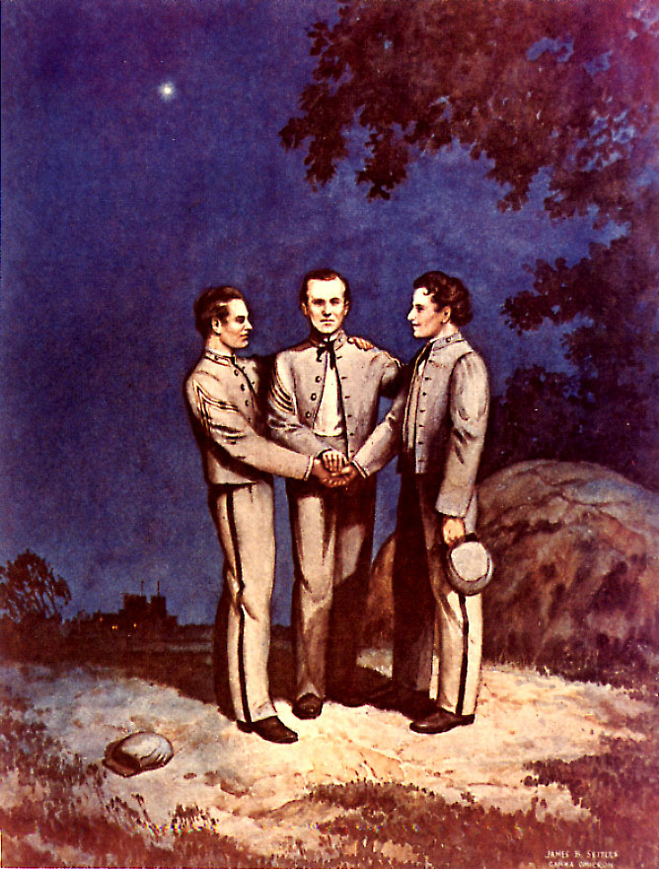
ΣΝ Jeopardy

Slide 2
THE FOUNDERS | Important Sigma Nus | THE CREED | SYMBOLS | All About Sigma Nu | Greek Alphabet | Risk Reduction | Iota Beta CHAPTER
100 | 100 | 100 | 100 | 100 | 100 | 100 | 100
200 | 200 | 200 | 200 | 200 | 200 | 200 | 200
300 | 300 | 300 | 300 | 300 | 300 | 300 | 300
400 | 400 | 400 | 400 | 400 | 400 | 400 | 400
500 | 500 | 500 | 500 | 500 | 500 | 500 | 500
Final Jeopardy

Slide 3
The Founders 100
Known as Alpha three, this founder was a member of VMI’s first baseball team and was Alpha chapter’s first commander.
Please use his Full Name
Back to Board

Slide 4
The Founders 200
Known as Alpha One, this founder came up with the Idea of creating Sigma Nu and served as the Lt. Commander of Alpha Chapter.
Please use his Full Name.
Back to Board

Slide 5
The Founders 300
Known as Alpha Two, this man served in the Confederate Army and was an advocate of the development of the public schools of Arkansas.
Please use his Full Name.
Back to Board

Slide 6
The Founders 400
This Founder drafted the first Ritual and designed the Badge.
Back to Board

Slide 7
The Founders 500
This many years passed between the enrollment of the founders in VMI and the Founding of Sigma Nu.
Back to Board

Slide 8
Important Sigma Nus 100
This Sigma Nu played Mr. Feeny on Boy Meets World and was the voice of “KITT” in Knight Rider.
Back to Board

Slide 9
Important Sigma Nus 200
This famous Sigma Nu coached the Alabama Crimson Tide for 25 years, winning 6 national championships and 13 conference crowns.
Back to Board

Slide 10
Important Sigma Nus 300
This Sigma Nu was the first legacy in Sigma Nu history.
Back to Board

Slide 11
Important Sigma Nus 400
This famous Sigma Nu piloted the plane (the Enola Gay) that dropped the atomic bomb on Hiroshima.
Back to Board

Slide 12
Important Sigma Nus 500
This individual is known as “the Keeper of the Rock” because he saved the founding Rock from being destroyed during VMI’s expansion.
Back to Board

Slide 13
The Creed 100
Finish the line,
To Believe in the _____________ ____ _______
Back to Board

Slide 14
The Creed 200
Finish the Line
To _____ in the Way of _________
Back to Board

Slide 15
The Creed 300
Finish the line.
This is the _____ the ______ and the ______ of _______ _______.
This is the ______ of our __________.
Back to Board

Slide 16
The Creed 400
He wrote the Creed of Sigma Nu.
Back to Board

Slide 17
Daily Double The Creed

Slide 18
Daily Double
The chapter and badge number of the Sigma Nu who wrote the Creed
Back to Board

Slide 19
Symbols 100
This symbolizes the purity of purpose.
Back to Board

Slide 20
Symbols 200
This animal is on our flag.
Back to Board

Slide 21
Symbol 300
The badge is modeled after the cross of what organization.
Back to Board

Slide 22
Symbol 400
These 2 items were in possession of every VMI cadet, one was part of their Formal Dress.
Back to Board

Slide 23
Symbol 500
Outside this building there is a 2-ton piece of the rock.
Back to Board

Slide 24
All About Sigma Nu 100
The name of Sigma Nu’s Magazine.
Back to Board

Slide 25
All About Sigma Nu 200
The three colors of Sigma Nu are…
Back to Board

Slide 26
All About Sigma Nu 300
There are this many Collegiate Sigma Nu Knights in the World.
Back to Board

Slide 27
All About Sigma Nu 400
Sigma Nu headquarters is located on the highest hill of this city.
City and State
Back to Board

Slide 28
All About Sigma Nu 500
Name of one of the three major paintings of Sigma Nu.
Back to Board

Slide 29
Greek Alphabet 100
This is the Greek letter pictured below.
Α
Back to Board

Slide 30
Greek Alphabet 200
This is the Greek letter pictured below.
Σ
Back to Board

Slide 31
Greek Alphabet 300
This is the Greek letter pictured below.
Δ
Back to Board

Slide 32
Greek Alphabet 400
This is the Greek letter pictured below.
Ρ
Back to Board

Slide 33
Greek Alphabet 500
This is the Greek letter pictured below.
Ξ
Back to Board

Slide 34
Risk Reduction 100
This is where the Risk Reduction Policy can be found.
Back to Board

Slide 35
Risk Reduction 200
Our insurance policy accounts for this much in coverage should there be an incident at a function hosted or co-hosted by Sigma Nu.
Back to Board

Slide 36
Risk Reduction 300
Sigma Nu does not allow the use of self-constructed ________ or similar activities.
Back to Board

Slide 37
Risk Reduction 400
For every “wet” social (social providing alcohol), there must be this many “dry” social (social without providing alcohol).
Back to Board

Slide 38
Risk Reduction 500
List at least 2 forms of hazing listed within the Risk Reduction policy.
Back to Board

Slide 39
Iota Beta Chapter 100
This is my position within our Chapter of Sigma Nu.
Back to Board

Slide 40
Iota Beta Chapter 200
This Brother extended your bid to you this semester.
Back to Board

Slide 41
Iota Beta Chapter 300
In this year our chapter was officially re-chartered with Sigma Nu.
Back to Board

Slide 42
Iota Beta Chapter 400
This man is the Director of Aquatics and Fitness on campus and an alumnus of the Iota Beta chapter.
Back to Board

Slide 43
Daily Double Iota Beta Chapter

Slide 44
Daily Double
This is how many active Brothers this chapter of Sigma Nu has.
Back to Board

Slide 45
Final Jeopardy
Make your bets

Slide 46
Final Jeopardy Question
This Founder joined the Chapter Eternal on May 6th, 1911.
Answer

Slide 47
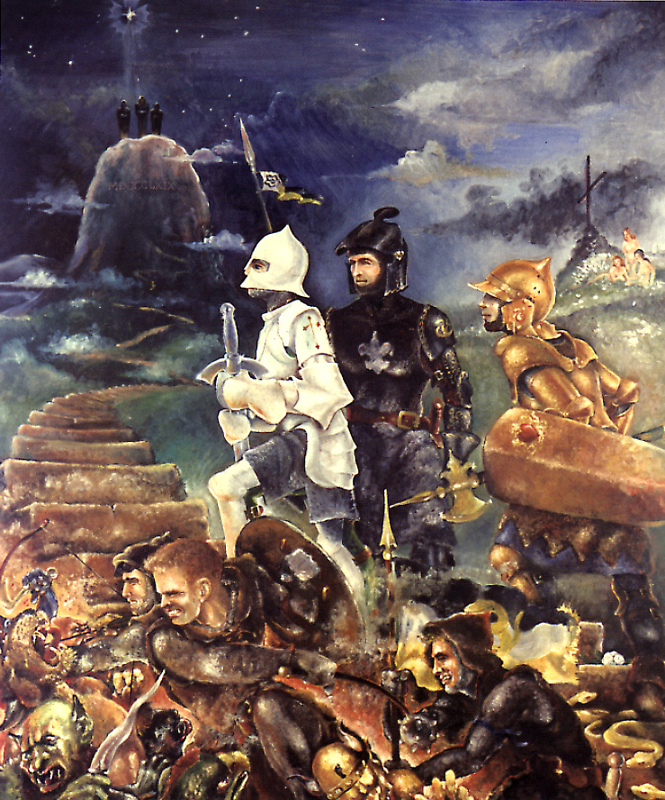
Answer
James McIlvaine Riley

